Slide 1

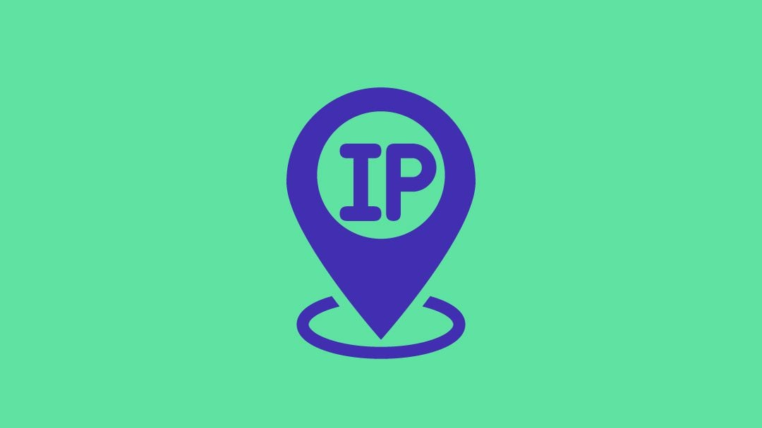
ព្រះរាជាណាចក្រកម្ពុជា ជាតិ​ សាសនា​ ព្រះមហាក្សត្រ
Royal University of Phnom Penh
ដេប៉ាតឺម៉ង់ៈព័ត៌មានវិទ្យា
Subject :​ data communication
Topic: Internet Protocol address
1

Slide 2
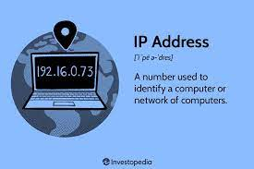
IP address
IP address (IP) is a unique numerical identifier for every device or network that connects to the internet
IPV4
IPV6
2

Slide 3
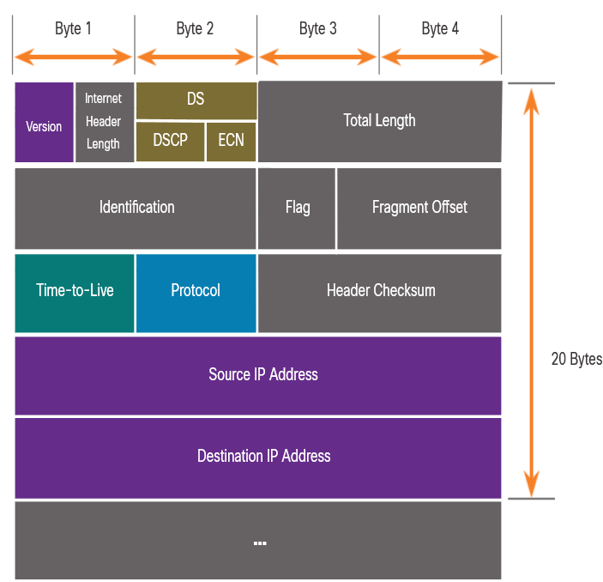
ipv4
IPv4 stands for Internet Protocol version 4. It is the fourth version of the Internet Protocol (IP) and is the most widely used protocol for connecting devices on the internet.
3

Slide 4
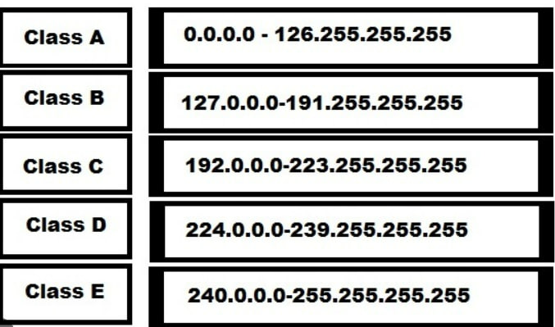
ipv4
In IPv4, there are five classes of IP addresses: A, B, C, D, and E. Each class has a different range of IP addresses and is designed for specific purposes.
IPV4 addresses are 32-bit binary numbers, typically represented in a human-readable decimal form known as dotted-decimal notation. In this notation, an IPv4 address consists of four sets of numbers separated by periods (e.g., 192.168.0.1).
IPV4 The total number of unique IPv4 addresses is limited to approximately 4.3 billion
4

Slide 5
Private IP
PUBLIC IP
A private IP address is an IP address that is used within a private network and is not directly accessible from the internet. Private IP addresses are reserved for use within local area networks (LANs) and are primarily used to allow devices on the same network to communicate with each other
A public IP (Internet Protocol) address is a unique numeric identifier assigned to a device or network interface connected to the internet. It allows the device to communicate and interact with other devices and services on the internet.
Private IP addresses are not routable over the internet, meaning they cannot be used to access websites or services directly from outside the local network. To connect to the internet, devices with private IP addresses typically use Network Address Translation (NAT), which translates private IP addresses to public IP addresses that can be used for
5

Slide 6

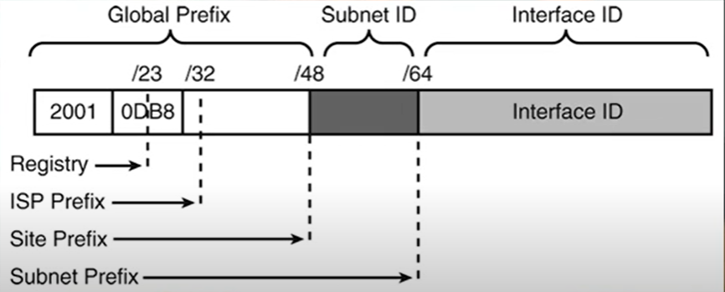
IPV6
IPv6 or Internet Protocol version 6, is the most recent version of the Internet Protocol (IP) that is used to identify and locate devices on a network. It is designed to replace the older IPv4 protocol, which has limitations in terms of available address space
6

Slide 7
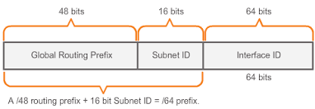
IPV6
IPv6 was developed to address the depletion of IPv4 addresses, as the number of connected devices and the demand for unique IP addresses increased. Unlike IPv4, which uses 32-bit addresses, IPv6 uses 128-bit addresses, providing a significantly larger pool of unique address
7

Slide 8
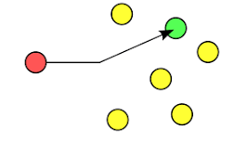
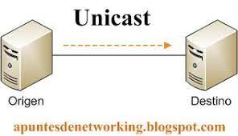
UNICAST
UNICAST is a one-to-one transmission from one point in the network to another point; that is, one sender and one receiver, each identified by a network address.
8

Slide 9
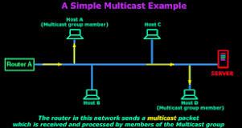
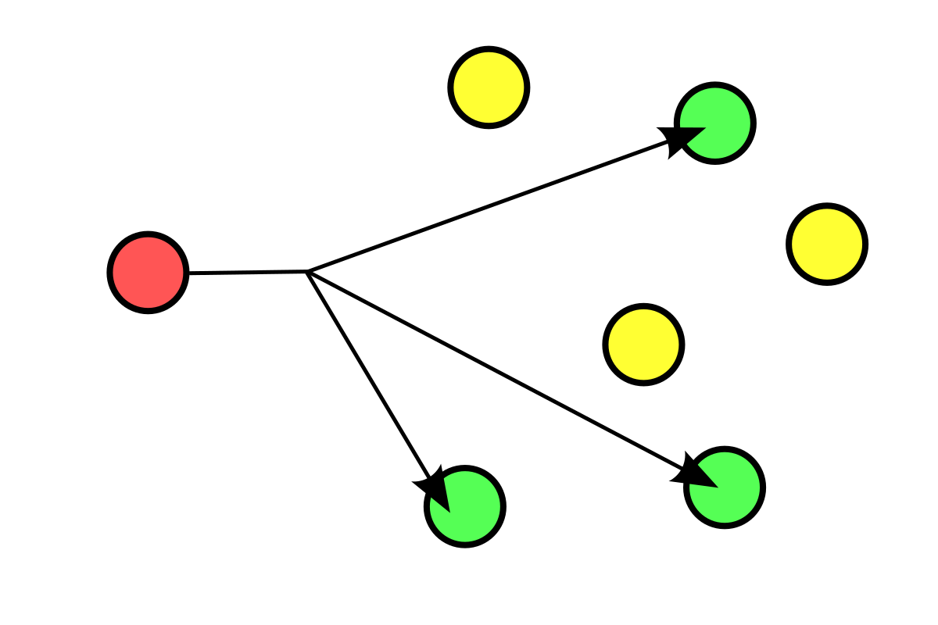
Multicast
Multicast is group communication where data transmission is addressed to a group of destination
Multicast can be one-to-many or many-to-many distribution. Multicast should not be confused with physical layer point-to-multipoint communication.
9

Slide 10
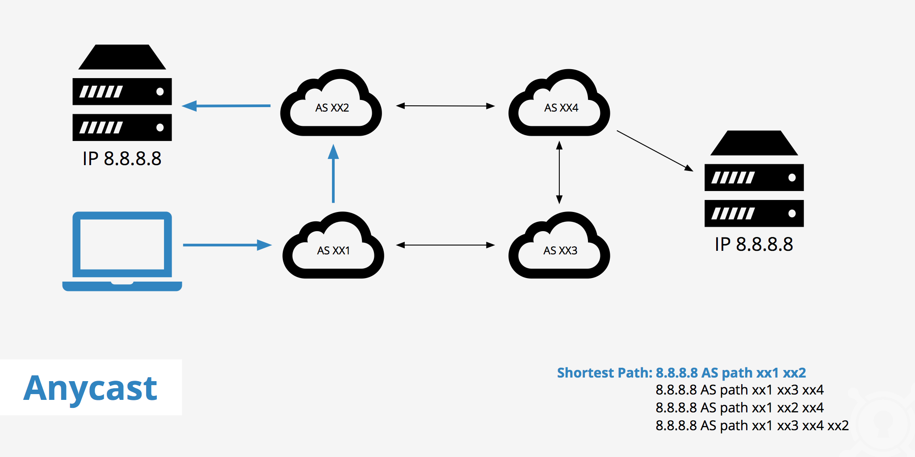
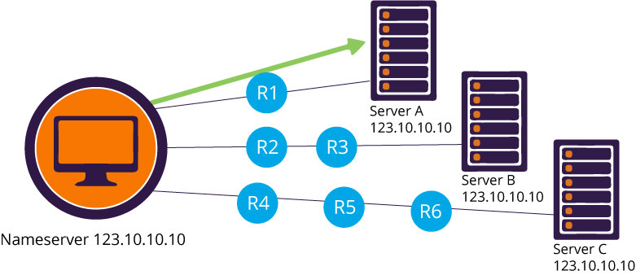
ANYCAST
An anycast address is an IP address that can be assigned to multiple devices or nodes in a network. It is a technique used in computer networking to provide a scalable and efficient way of delivering packets to the "nearest" node among a group of potential destinations.
10

Slide 11

10
11

